Slide 1
Bank Loan Status|Finance

Slide 2
Project Objective
This is Bank loan of Customers project where we were provided with 2 datasets with .csv extension files having 39k rows each and the objective was to analyze the growth that bank got within given years in loans.
I used MS-Excel, Power Query for cleaning and removing duplicates from dataset and prepared dashboard using PowerBI tools where we did calculations, merging and prepared interactive dashboards.

Slide 3
Contents
KPI-1 : Year wise loan amount Stats
KPI-2 : Grade and sub grade wise revol_bal
KPI-3 : Total Payment for Verified Status Vs Total Payment for Non Verified Status
KPI-4 : State wise and last_credit_pull_d wise loan status
KPI-5 : Home ownership Vs last payment date stats

Slide 4
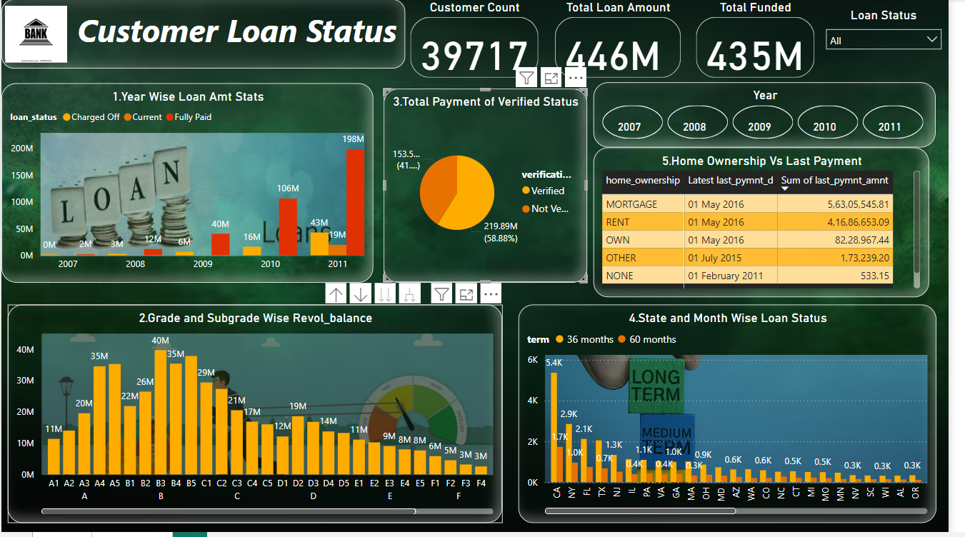

Slide 5
1,The sum of loan amounts exhibited an upward trend from 2007 to 2011, increasing by 258.28 million during this period 2,At 161.3 million, B claimed the top spot for the highest Sum of revolving balance, far outpacing G's Sum of revolving balance, which was a mere 6.46 million dollars in comparison. 3, The total annual income for individuals with a verified status exceeded that of those with a non-verified status. Specifically, verified status comprised 68.19% of the overall payment, while non-verified status accounted for 31.81% 4, Among the different categories, MORTGAGE takes the lead with a substantial 52.92% share of the total Sum of last payment amount in home ownership, followed closely by the rent and own categories 5, The number of loans with a 36-month term, totaling 18,977, exceeded the count of loans with a 60-month term, which was 6,563. In the context of a 36-month term, the loans in California (CA) constituted 20.99% of the total count of loan statuses

Slide 6
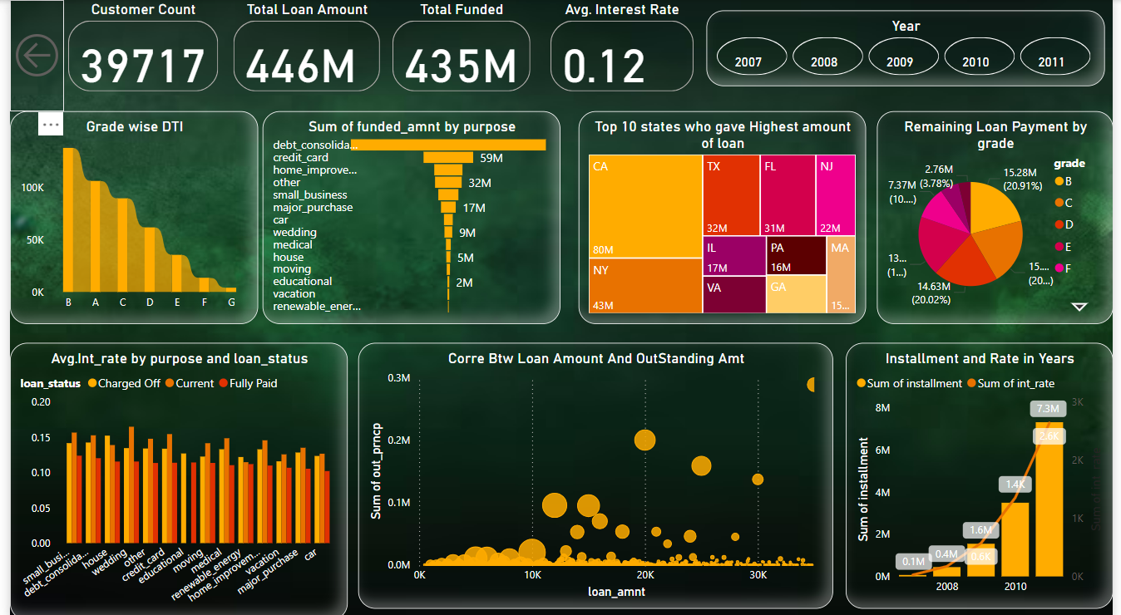

Slide 7
Valuable Insights
❖In KPI 2 grade B has a much higher sum of revolving balance than grade G, which could mean that they have different levels of financial stability or creditworthiness.
❖The data clearly indicates a significant increase in the total loan amounts between 2007 and 2011.This information is crucial as it enables us to understand the broader economic scenario and make informed decisions while managing their loan portfolios.
❖We can understand that individuals with verified status make significantly larger contributions to overall payments compared to those without verification. This highlights the crucial role of verifying applicant information in assessing risk and making informed decisions.
❖MORTGAGE appears to be the dominant category in terms of the last payment amount. Clients may want to focus on this category for potential investment opportunities or marketing strategies.
❖Analyzing the distribution of loans by their term duration, such as 36-month or 60-month loans, is vital for assessing risk and allocating resources effectively. A higher number of 36-month loans indicates a prevailing trend in this category. This trend provides valuable insights for our clients to make informed decisions.
❖These insights can be applied to make better decisions in areas like loan eligibility, marketing tactics, and resource allocation, enhancing their operational effectiveness

Slide 8
Thank You

